Slide 1



Department of Computer Science and Engineering
CS191P11 –IOT
THE SMARTFIRE EXTINGUISHER
ISHITHA S -230701117
ISHWARI RAJMOHAN -230701118

Slide 2
ABSTRACT
The SmartFire Extinguisher is an IoT-based robot designed to detect and extinguish fires quickly and safely. Using IR flame sensors, it detects fires, and an Arduino UNO processes the data to navigate towards the source. The robot has two modes: autonomous, where it avoids obstacles and navigates independently, and manual, where it can be controlled remotely. This system offers a safe, cost-effective solution for fire management, especially in dangerous or hard-to-reach areas. The system provides a cost-effective, scalable, and safe alternative for fire management, especially in hazardous or hard-to-reach areas. Planned future upgrades include Android-based remote monitoring, AI for fire-type detection, robotic arms for rescue operations, and drone-based aerial firefighting to handle large-scale incidents like forest fires more effectively.

Slide 3
Introduction
Fire disasters can cause serious damage, and traditional methods put firefighters at risk, especially in dangerous places. With advances in robotics and IoT, there’s an opportunity to create systems that can fight fires without putting people in danger.
The SmartFire Extinguisher is an IoT-based robot designed to detect and extinguish fires automatically. Using IR flame sensors, it finds fires and takes action to put them out. The robot offers a safer and faster solution for fire management, reducing human risk in hazardous environments.

Slide 4
Problem Statement
Fire accidents pose a significant risk to life and property, especially in areas where human intervention is unsafe or delayed. Traditional fire-fighting methods may not always be effective. This project develops "THE SMARTFIRE EXTINGUISHER," an IoT-based robot designed to autonomously detect and extinguish fires, reducing human risk and improving fire safety.

Slide 5
Proposed Work
Autonomous Fire Detection and Response: The system integrates IR flame sensors with an Arduino-controlled mobile robot that autonomously navigates toward fire sources, avoiding obstacles and extinguishing fires using a servo-controlled water pump.
Dual Operational Modes with Remote Accessibility: The robot supports both autonomous and manual (IoT/RF-based) control modes, allowing real-time remote operation in hazardous areas, ensuring flexibility and enhanced safety in various fire-prone environments.
Sensor Integration: The robot utilizes infrared (IR) flame sensors to detect the presence of fire. These sensors continuously monitor the surroundings and relay data to the Arduino UNO, which processes the information to determine if a fire is present.

Slide 6
Implementation
Arduino UNO and Motor Control: The Arduino UNO acts as the central controller, processing data from the sensors and guiding the robot's movements. The robot’s movement is managed by DC motors controlled via an L298 motor driver, ensuring precise navigation toward the fire source.
Fire Extinguishing Mechanism: Upon detecting a fire, the robot activates a servo-controlled nozzle and water pump system. The nozzle directs the water, and the pump ensures a continuous flow to extinguish the fire.

Slide 7
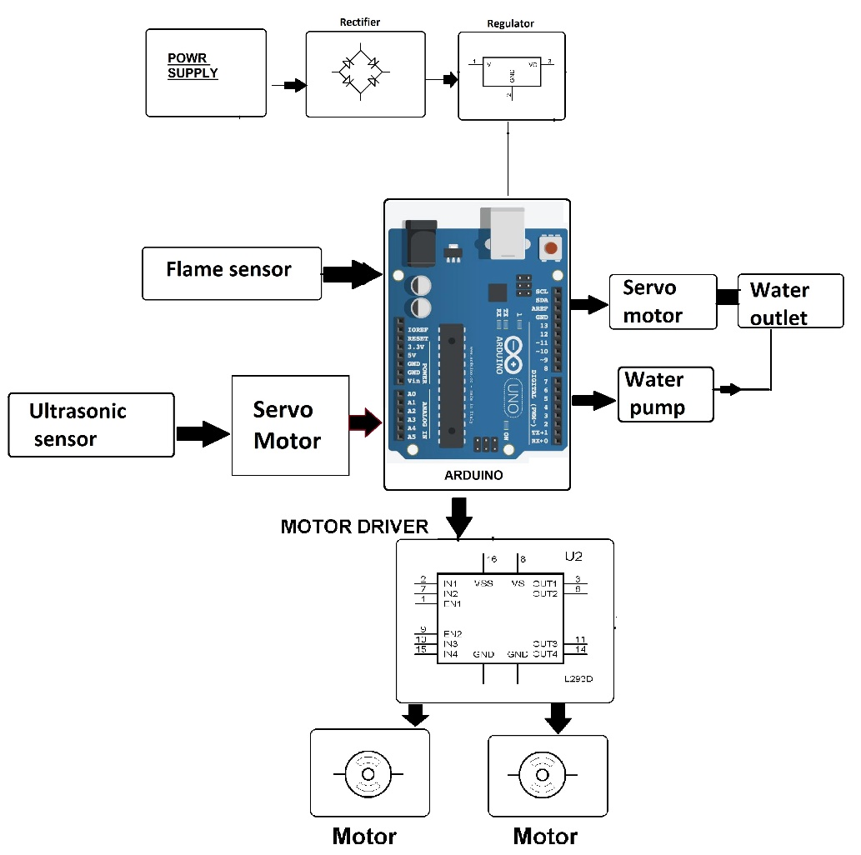
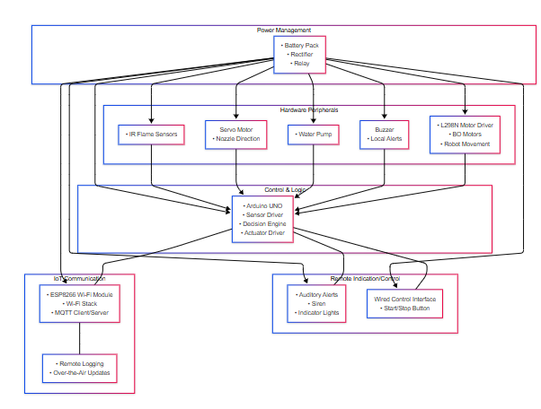
Architecture

Slide 8
System requirements
Arduino UNO software
IR Flame Sensor
Switches
Buzzer
Actuators
L298N Motor Driver Module

Slide 9
Advantages of the proposed system
Alerts nearby personnel with a buzzer to ensure immediate awareness of fire.
Flexible deployment across homes, factories, warehouses, and remote sites.
Precise navigation and targeting minimize water waste and collateral damage.
Reduces risk to human firefighters by operating autonomously in hazardous areas.
Provides rapid, real-time fire detection and suppression, limiting property damage.

Slide 10
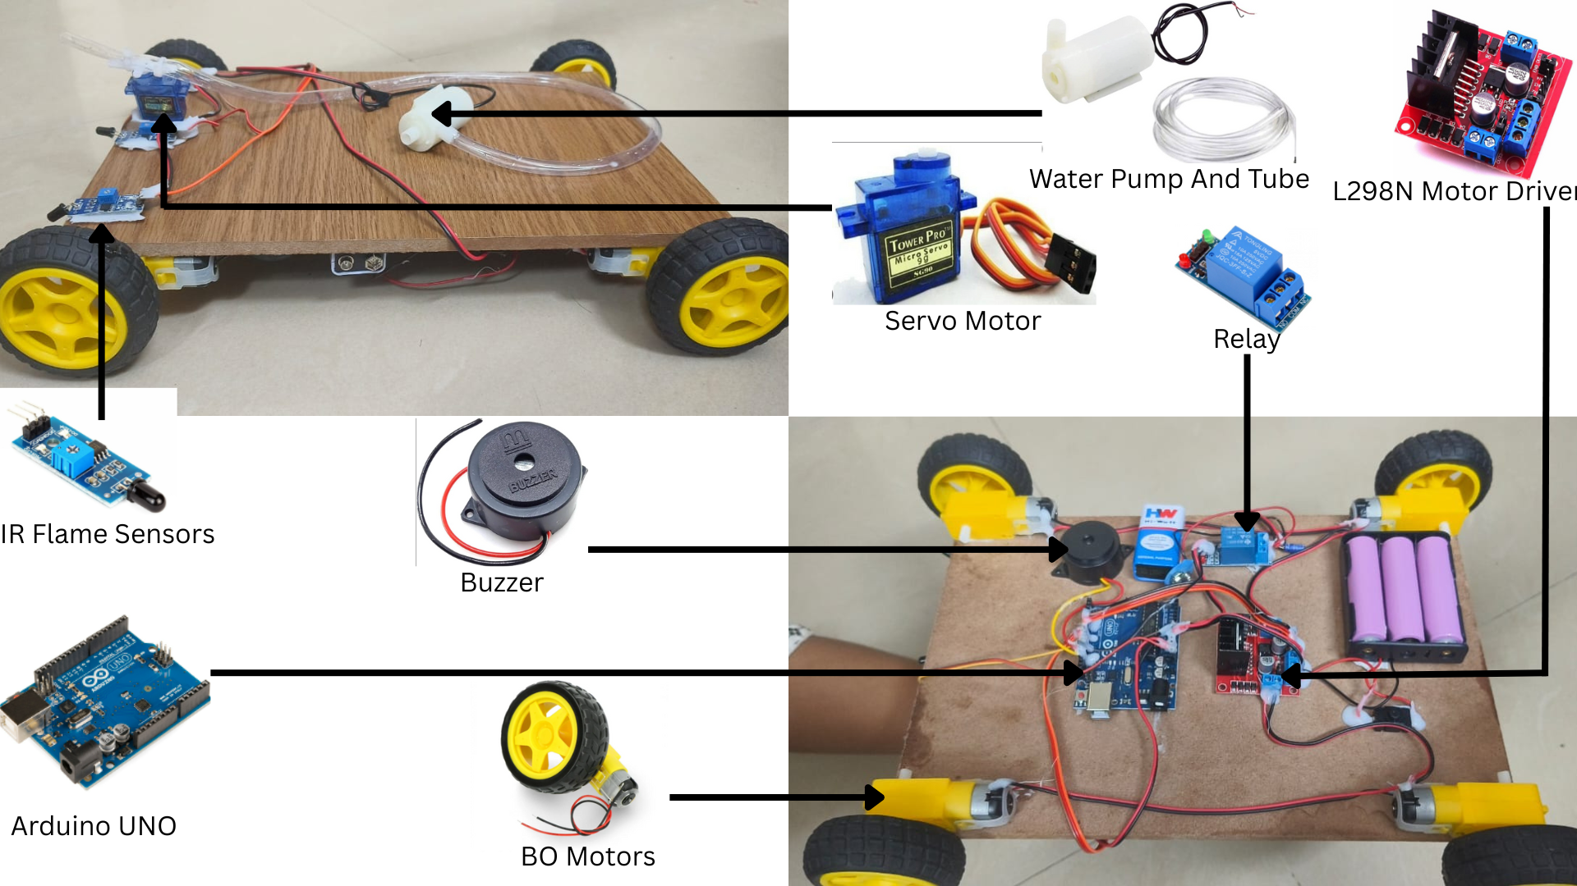
THE PROTOTYPE

Slide 11
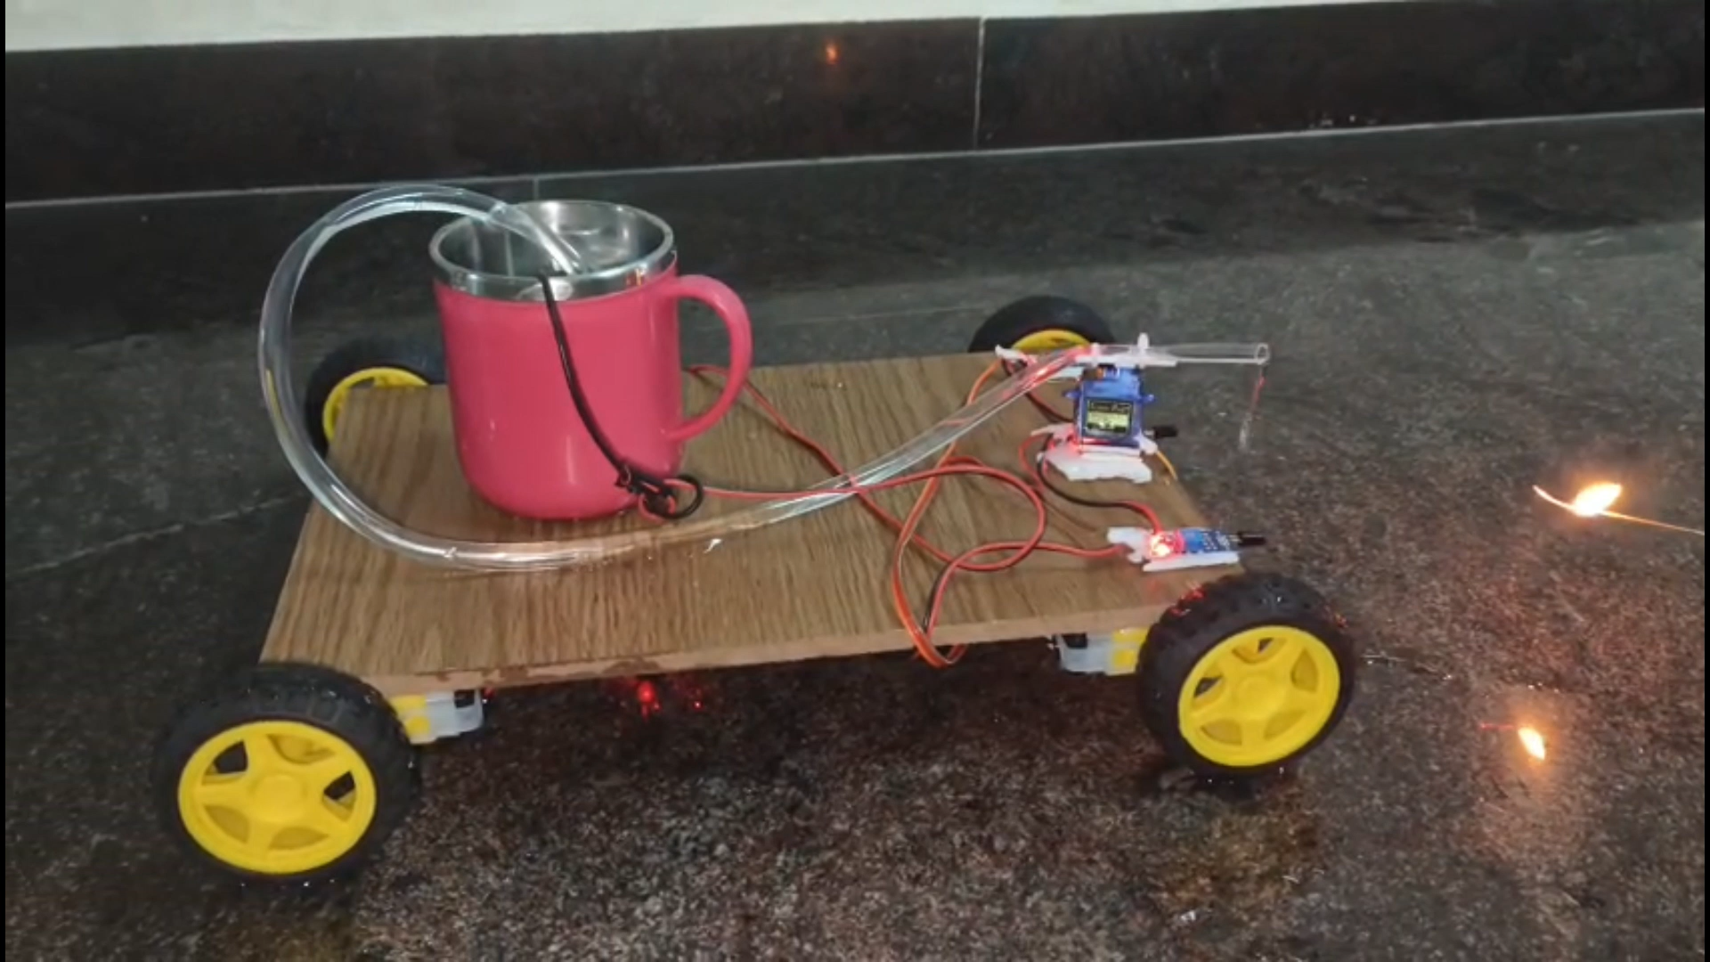
WORKING MODEL

Slide 12
Implementation
The robot uses IR flame sensors to detect fire from different directions.
Arduino UNO processes sensor data and directs the robot’s movement with BO motors and an L298 motor driver.
Once fire is detected, a servo-controlled nozzle and water pump activate to suppress the fire.
A buzzer alerts nearby individuals when fire is detected.

Slide 13
Implementation
The system is designed to reduce human intervention in hazardous fire situations, enhancing firefighter safety.
Designed to reduce firefighter risk by operating in hazardous areas without human intervention.
The robot is versatile, suitable for homes, industries, and remote areas.
Future enhancements may include predictive maintenance and solar power to increase operational time.

Slide 14
Conclusion
The SMARTFIRE EXTINGUISHER IoT-based autonomous fire-fighting robot represents a significant advancement in fire safety and emergency response. By integrating real-time fire detection through IR flame sensors, autonomous navigation, and an automated water-spraying mechanism, the system offers an innovative and cost-effective solution for fire control. The robot’s ability to operate in both autonomous and manual modes provides flexibility, ensuring that it can efficiently tackle fires with minimal human intervention. This system not only reduces the risks associated with human involvement in fire-fighting but also ensures a rapid, reliable, and automated response to fire incidents.

Slide 15
References
[1] K. R. Swetha, N. B, U. Afreen and M. D, "Fire Detector and Sprinkler Autonomous Robot," 2023 International Conference on Recent Advances in Science and Engineering Technology (ICRASET), B G NAGARA, India, 2023, pp. 1-6, doi: 10.1109/ICRASET59632.2023.10419930.
[2] M. Diwanji, S. Hisvankar and C. Khandelwal, "Autonomous Fire Detecting and Extinguishing Robot," 2019 2nd International Conference on Intelligent Communication and Computational Techniques (ICCT), Jaipur, India, 2019, pp. 327-329, doi: 10.1109/ICCT46177.2019.8969067
[3] . H. Afzaal and N. A. Zafar, "Robot-based forest fire detection and extinguishing model," 2016 2nd International Conference on Robotics and Artificial Intelligence (ICRAI), Rawalpindi, Pakistan, 2016, pp. 112-117, doi: 10.1109/ICRAI.2016.7791238.
[4] S. Usha, W. Jessica Sharon and M. S. Shrajana, "Fire Detection and Extinguishing Robot Using Arduino," 2024 International Conference on Communication, Computing and Internet of Things (IC3IoT), Chennai, India, 2024, pp. 1-6, doi: 10.1109/IC3IoT60841.2024.10550218.

Slide 16
Thank You

